Slide 1
Computer Science 20
Boolean Logic

Slide 2
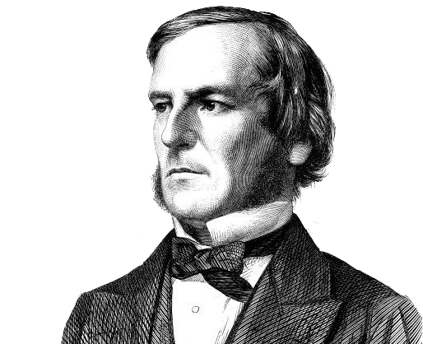
What is a Bool(e)?
Boolean Logic is a form of algebra where all values are reduced to TRUE or FALSE
Developed by mathematician George Boole
Really important in computer science as it maps well to the binary number system.
Each bit in a computer is either 0 or 1
0 = FALSE 1 = TRUE

Slide 3
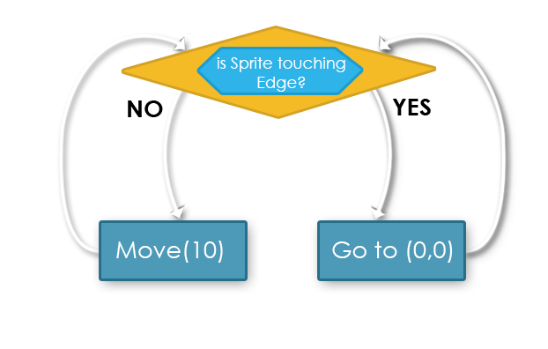
The Basics
We’ve already seen that Branching (IF) statements rely on a statement that can be evaluated to TRUE or FALSE when choosing which branch a program should follow

Slide 4




Moving Beyond
LOGICAL OPERATORS
More complex conditions can be evaluated by using Logical Operators
Just like arithmetic operators can be used to combine numerical values, logical operators can be used to combine logical values.

Slide 5
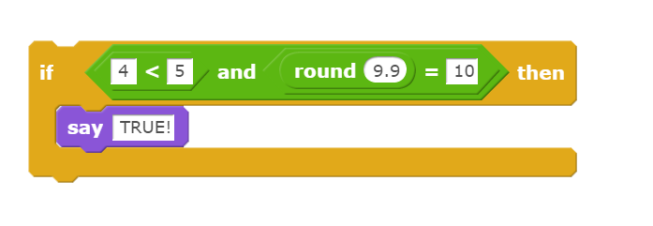
Joins two separate Boolean terms, and only evaluates to TRUE if both individual terms are true.
If (4<5) AND (round(9.9)==10) evaluates to TRUE
IF (TRUE) AND (TRUE)
IF TRUE
If one or more terms are false, the whole statement evaluates to FALSE

Slide 6
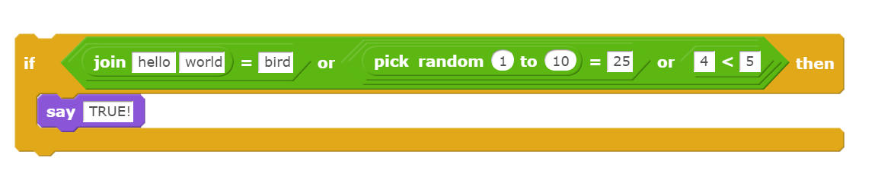
Joins two separate Boolean terms, and only evaluates to TRUE if at least one term is TRUE.
If (“hello”+”world” == “bird) OR (random(1,10)==25) OR (4<5) evaluates to TRUE
If (FALSE) OR (FALSE) OR (TRUE)
IF TRUE
If all individual terms are false, the whole statement evaluates to FALSE

Slide 7

NOT
Inverts a logical operator. True becomes false, and false becomes true.
If NOT(“hello”+”world” == “bird”)
If NOT (FALSE)
If TRUE

Slide 8
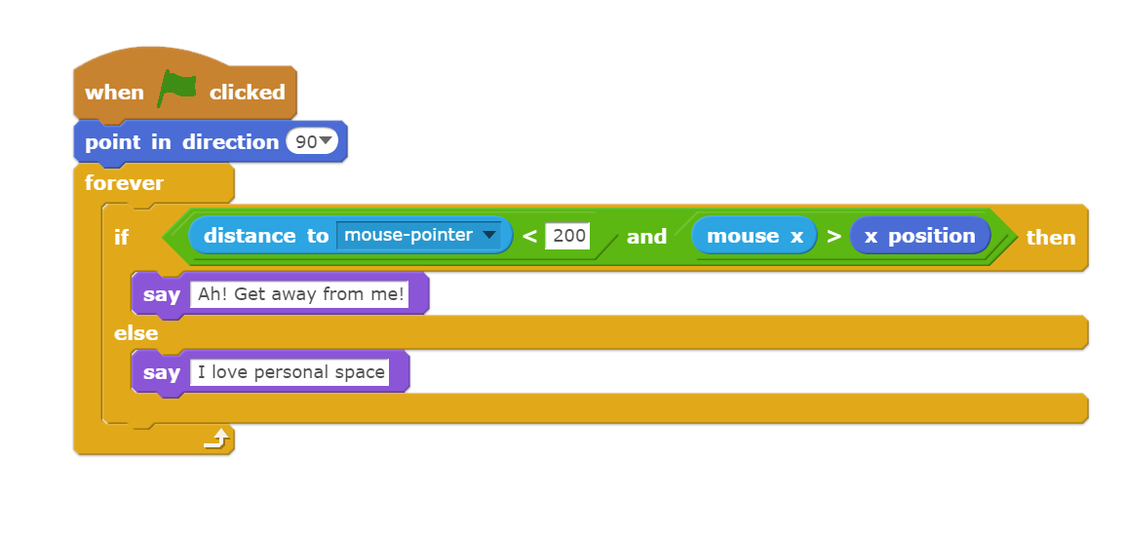
Those Examples
You may have observed that the previous examples are all static conditions and will always be evaluated the same way!
Their simplicity is useful for demonstrating how Logical Operators (AND, OR, !) work, but would never be used in practice.
Instead, we see conditions which can evaluate to either true or false depending on the current state of the program:

Slide 9



Animation Exercise Pseudocode
Pseudocode is a plain-English algorithm; sort of like a rough draft.
Once made, it provides an outline for constructing the solution in code.
Idle: 1-6
Psuedocode algorithm for choosing the correct next costume in an animation:
IF the current costume is part of an earlier or later set of costumes:
- set the current costume to the first of the desired set.
ELSE (the costume is part of the desired set) :
IF the costume is the last one of the set:
- set the current costume to the first of the set
ELSE (there is still at least one costume to still use in the set):
- change to the next costume
Run: 7-12
Swipe: 13-18

